Slide 1
Friendsgiving Presentation

Slide 2

What is Friendsgiving?
Friendsgiving is an Open Business Day
wrapped in a Thanksgiving Hug!

Slide 3

Planning
Schedule
  Create schedule
  Promote to Leadership via Roundtable
  Share the Food Signup sheets
  Share Certificates and the one pager on How to Use the Certificate.
  For Online Chapters, share the fillable pdf and give instructions on returning them, so your team can create a slide deck of the certificates.

Slide 4
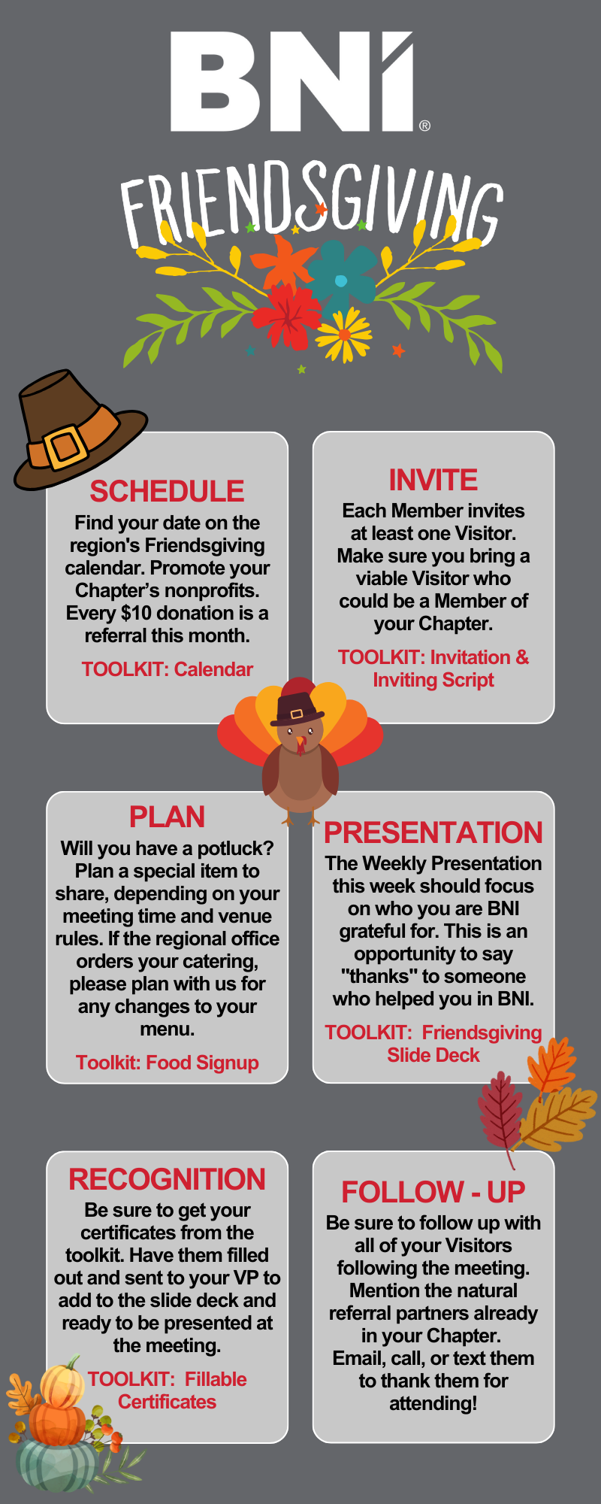

Slide 5
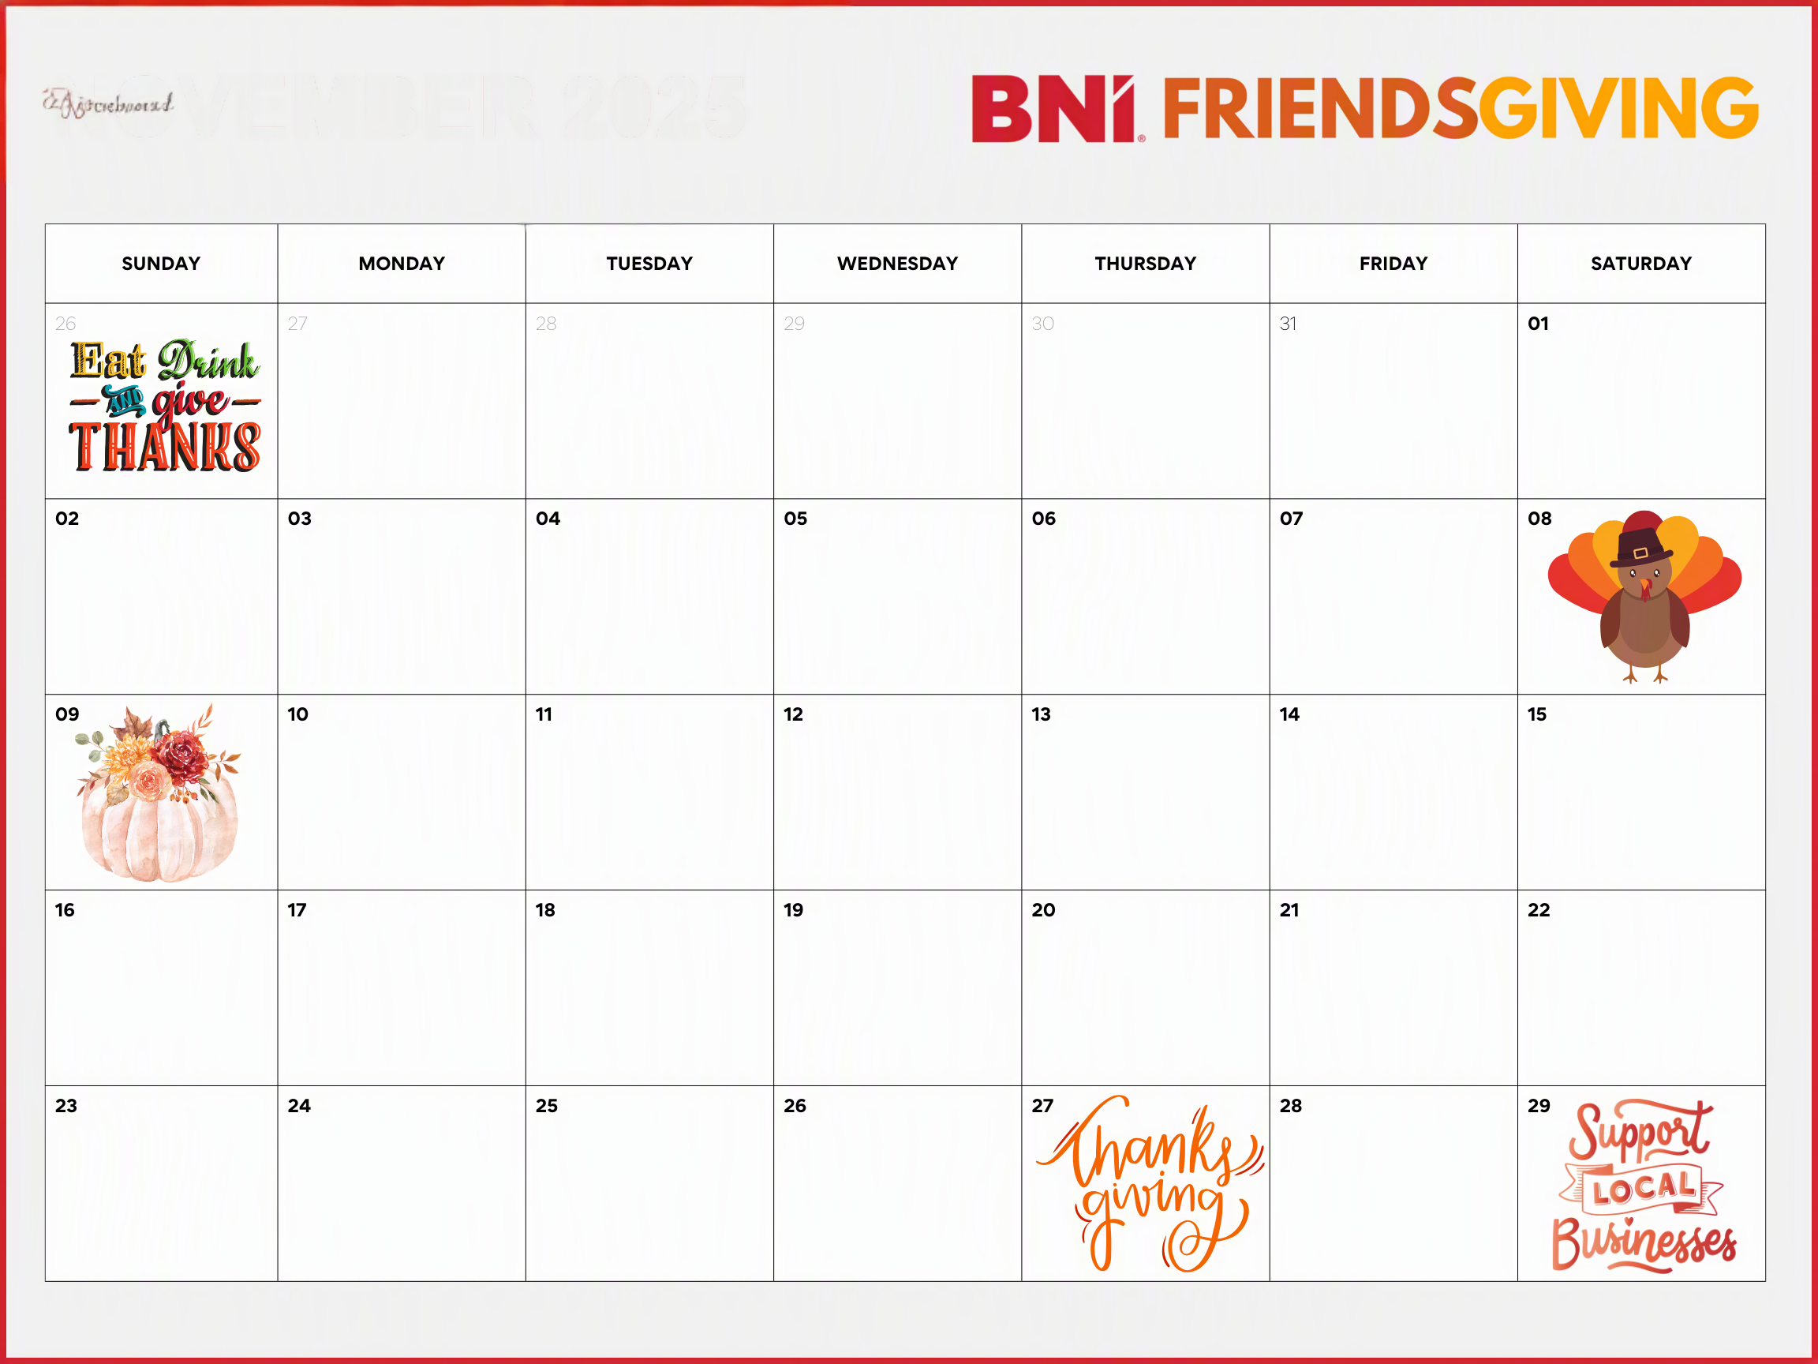

Slide 6


Slide 7
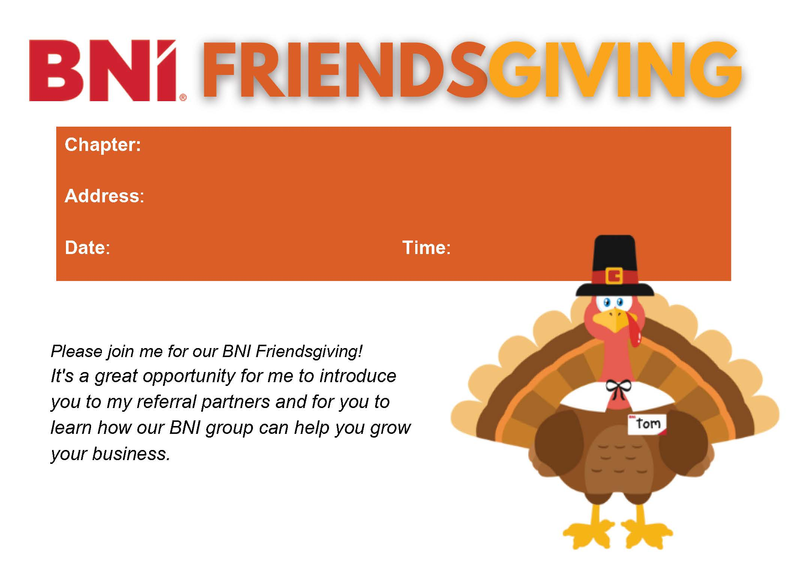

Slide 8


Slide 9

Promote
  Inviting
    Share invites with Chapter
    Share scripts for inviting over email, text messages, and phone calls/in-person
  Facebook Drip Campaign
    Create excitement and keep the event top of mind by sharing a Friendsgiving tip via the Facebook group
  Introduce the Non-Profit Component
    Get the non-profits involved, we will be encouraging $10 or more donations on the Chapters Friendsgiving Day.
    The more Visitors, the more opportunities for donations.

Slide 10
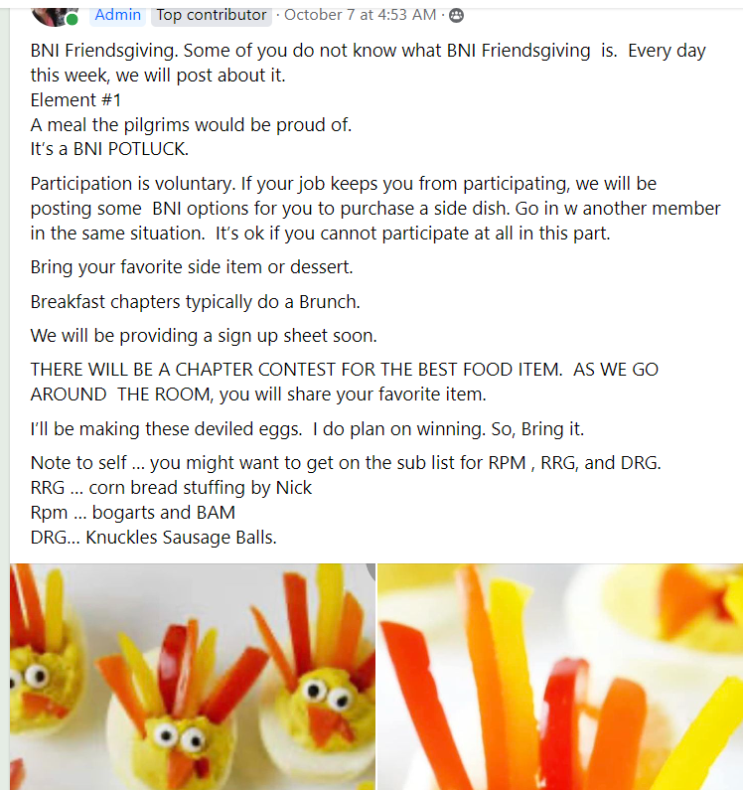
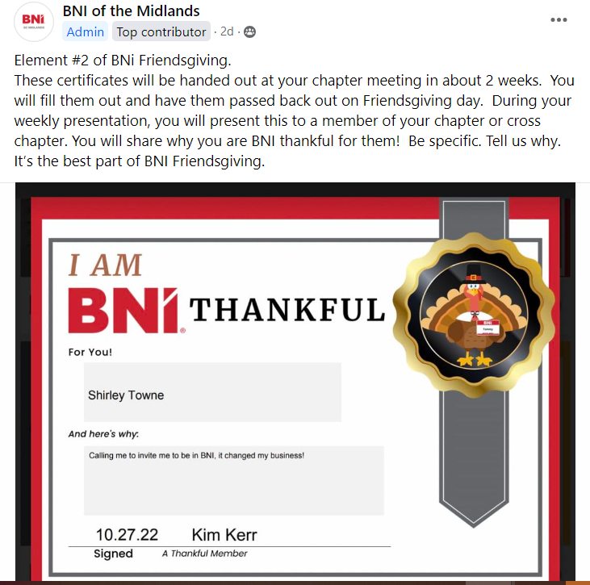

Slide 11

Invite
  Share invites with Chapter and encourage everyone to invite a minimum of 5 Visitors.
    Be sure to register your Visitors!
    Create accountability partners or have a follow up team to follow up with invited Visitors.
    Share the digital invite on your social media.
    Give a heart felt testimony about on your social media BNI and how it has impacted your business.

Slide 12

During the Event
Be welcoming
Personally introduce the Visitors with natural referral partners
Give a compelling BNI Thankful presentation during your 45 seconds. Be specific, specific is terrific. If your “Thankful for” BNI Member is there, present the certificate.

Slide 13
Follow Up
TAKE CARE OF YOUR VISITOR
Be sure that the Visitor is registered.
Be sure your Visitor Host sent them an application.
Send an email or text to thank them for attending.
  Ask if there were any members that they would like a personal introduction to.

Slide 14
Presentation @ BNI Friendsgiving
At our Friendsgiving meeting, this is how it goes…

Slide 15

WELCOME TO
Enter Name
Friendsgiving
Please enjoy OPEN NETWORKING
Welcome to BNI!
Notes:
Breakout Rooms for Open Networking/Visitor Orientation run by Secretary/Treasurer.

Slide 16
Friendsgiving is an Open Business Day wrapped in a Thanksgiving Hug!
WELCOME!

Slide 17
Our Fantastic Leadership Team
President: Member
Vice President: Member
Secretary Treasurer: Member
Membership Committee: Member, Member, Member
Visitor Host Team: Member
Education Coordinator: Member | Mentor Coordinator: Member
Growth Coordinator: Member | Event Coordinator: Member
Communication Coordinator/Webmaster: Open
Time Keeper: Member

Slide 18


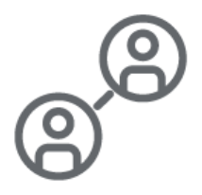




WHAT IS YOUR FAVORITE CORE VALUE & WHY
Givers Gain®
Be willing to give first, before you expect to gain. Giving unconditionally creates a better world for everyone and creates important opportunities and lasting relationships.
Building Relationships
Building strong relationships creates an environment of trust and support that yields happiness, opportunity and meaning.
Lifelong Learning
Invest in yourself to become the leader you want to be. Your value grows as you develop your knowledge and skills. Lifelong learning and lifelong happiness are intimately connected.
Traditions + Innovation
We honor our traditions and look to a brighter future fueled by innovation, optimism and excitement.
Positive Attitude
We find the good in everything that happens to us, and that propels our lives forward. Finding the good in every person enables us to attract terrific people, opportunities, and wealth.
Accountability
We keep the promises we make, especially when it is hard to do so. This creates trust and supports strong relationships.
Recognition
We appreciate that recognition fuels the growth of successful organizations. The person who masters the art of recognition attracts success that leads to meaning and happiness.
Notes:
“In unique circumstances like this, it’s great to remember our Core Values and what binds us together as Members of BNI. Today, I’d like to have <NAME> share with us.

Slide 19
WEEKLY PRESENTATIONS
You have 45 seconds to make a memorable impression, make it count.
Share with us the one member, referral, or opportunity that you are most BNI thankful
Share the one potluck item that is your favorite, (By popular vote, the favorite, wins a prize!)
Visitors, Sit back and enjoy, we will hear from you next.
Notes:
This is the time in the meeting when we give Members a brief moment to continue the process of educating their fellow Members on who they are, what they do, how they add value and what sort of business they are looking for. We will go in alphabetical order by first name. During your turn, please unmute your microphone. Your time will be limited to 60 seconds, please watch your slide for your timer.”
“Visitors, please remember to make note of anyone you would be interested in meeting from our Chapter. Our Visitor Host Team can help set up introductions for you at the end of the meeting.”

Slide 20

VISITOR INTRODUCTIONS
How Can We Help You?
Notes:
Visitors we appreciate you attending the meeting today. Our Secretary / Treasurer will call on you by name.
We are very excited to learn about what you do.

Slide 21


VISITOR INTRODUCTIONS
Please share with us:
Name
Business Name
Who invited you today?
Share one thing about your business that we need to know.
Name
Company Name
60
0
1
2
3
4
5
6
7
8
9
10
11
12
13
14
15
16
17
18
19
20
21
22
23
24
25
26
27
28
29
30
31
32
33
34
35
36
37
38
39
40
41
42
43
44
45
46
47
48
49
50
51
52
53
54
55
56
57
58
59
60

Slide 22
VICE PRESIDENTS REPORT
name
Company
 | Weekly | Month to Date | Year to Date | Goal
TYFCB |  |  |  | $500,000.00
1:1s |  |  |  | 80/month
Referrals |  |  |  | 80/month
CEU |  |  |  | 960
Visitors |  |  |  | 100
Notes:
Explain each metric when going over the annual numbers for the Chapter.

Slide 23
Featured Non-Profit
Now we want to mention our BNI featured Non-Profit and their mission.
We will be passing around a hat if a member would like to donate. You can also click on any QR code to donate to the BNI non-profit of your choice.

Slide 24
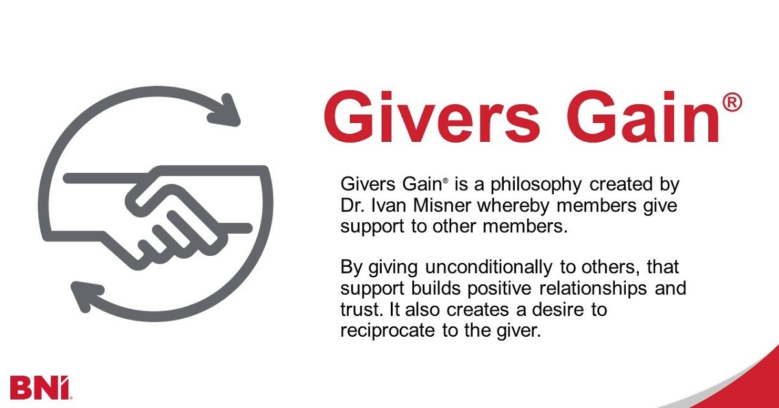
In Closing…

Slide 25
CLOSING QUOTE
“Gratitude is the healthiest of all human emotions. The more you express gratitude, for what you have, the more likely you will have even more to express gratitude for.”
-Zig Ziglar

Slide 27

Resources: Certificates

