Slide 1
Registering Visitors
Or Guest or Substitute

Slide 2
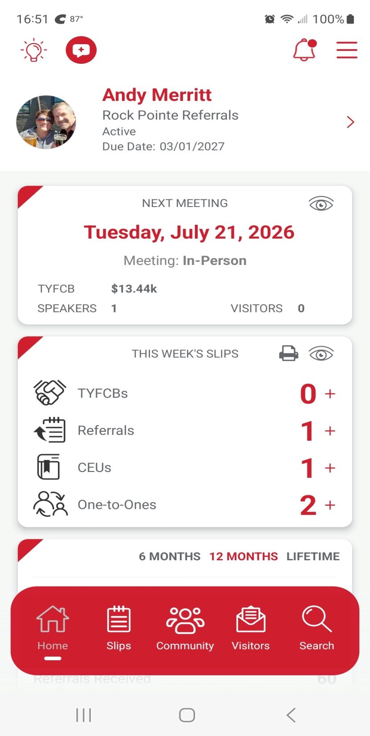
Take out your phones and go to the BNI connect app.
Before every meeting you can check to see if we already have visitors and who the weekly speaker is. (see highlighted area)
At the bottom right of the app you can click on Visitors. (circled in blue)

Slide 3
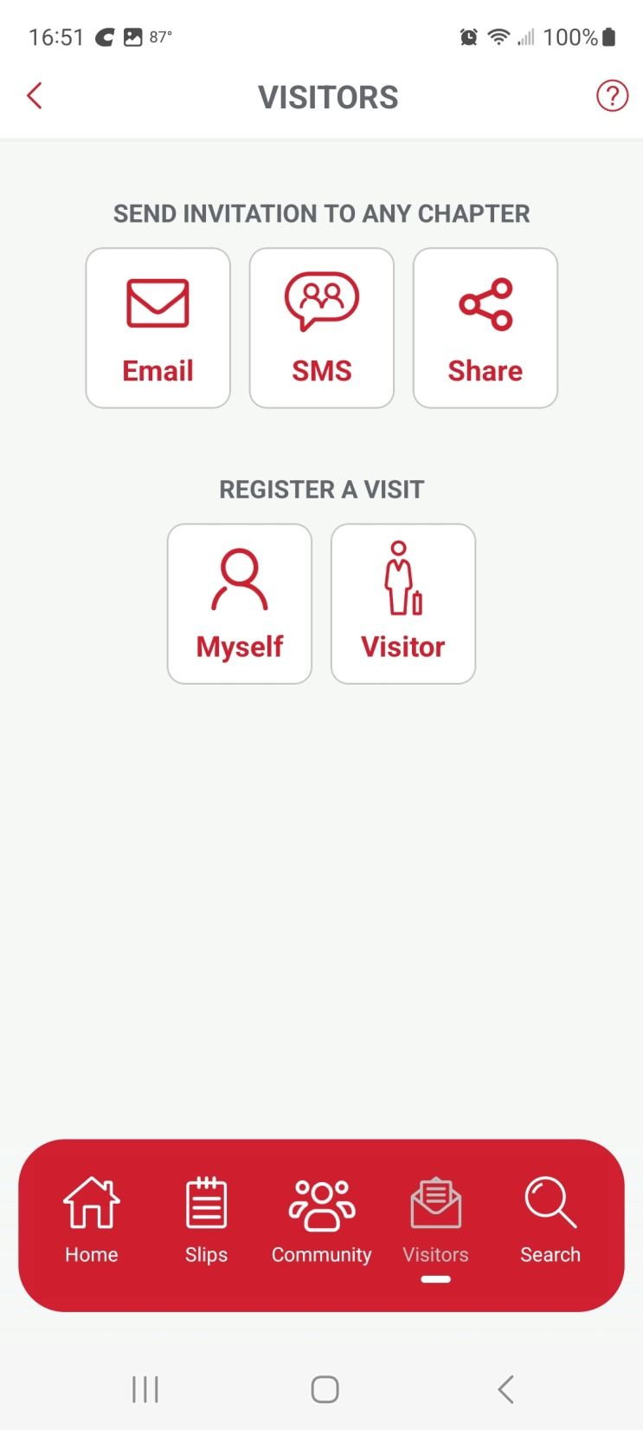
This will take you the “register a visitor” page. You can also send out an invitation to a potential guest, but registering them yourself will make sure our leadership has a heads up and keeps a better record of our visitors.
Click on “Visitor”

Slide 4
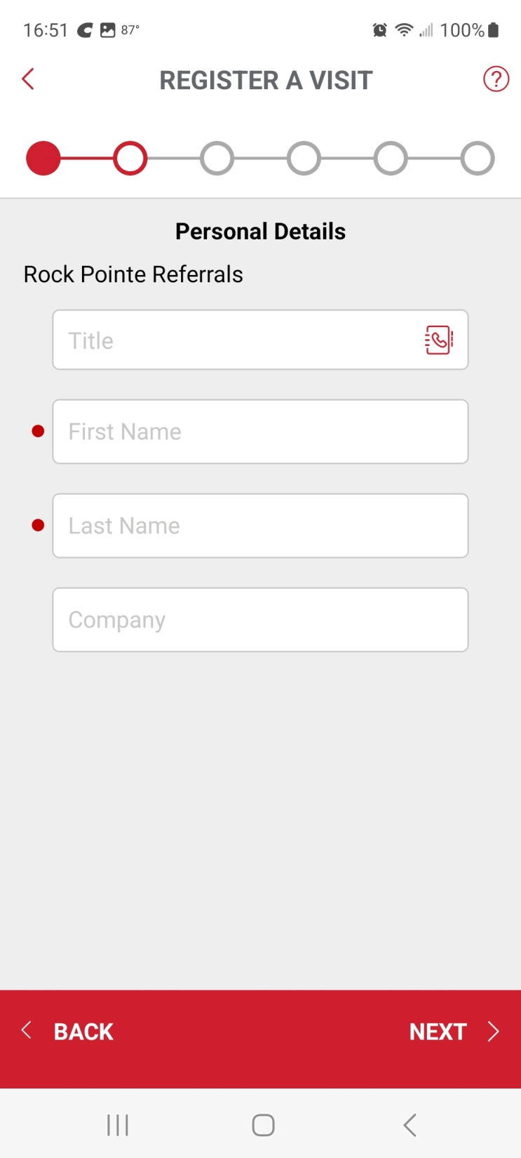
This will take you to the “Personal Details” page. Ask your visitor for their business card. This is the best way to get the information you need to enter it into the BNI app.

Slide 5
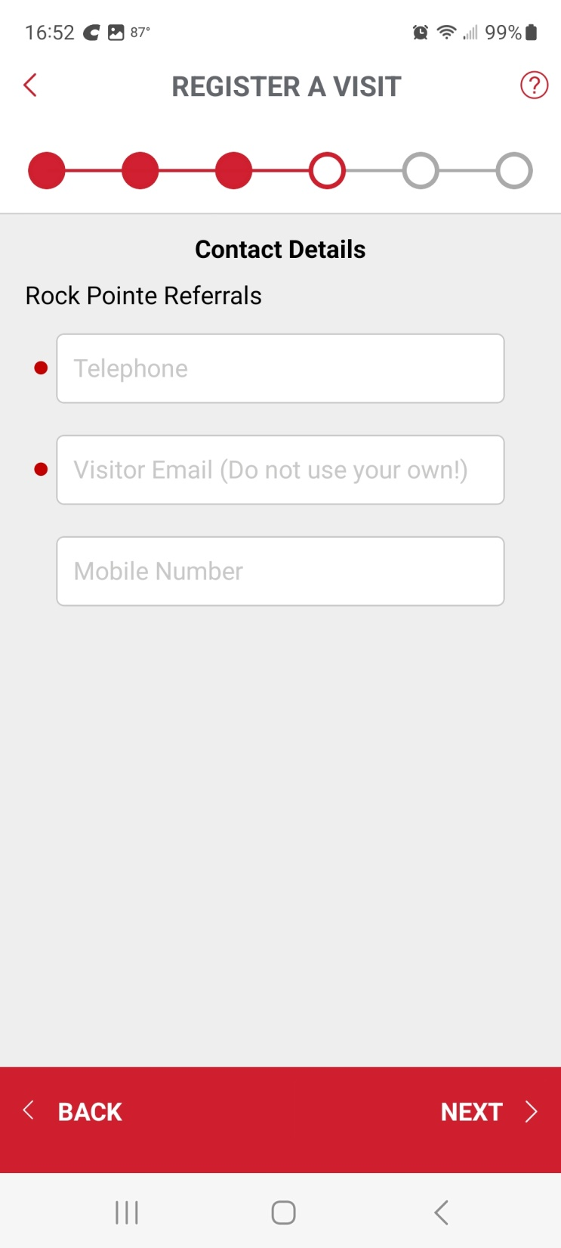
Once you click “Next” you will get contact details. Red dots indicate must have information

Slide 6
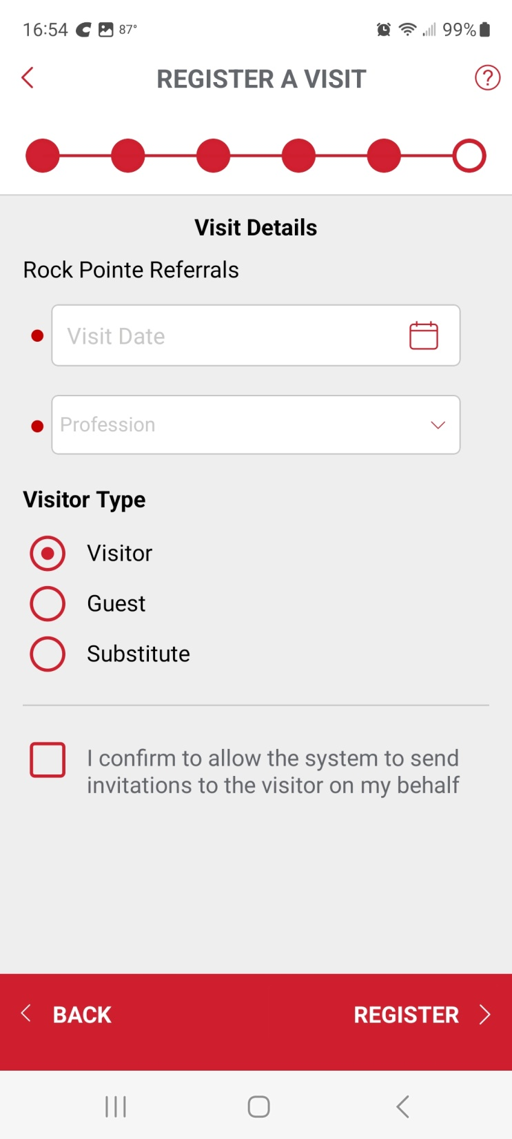
Once you click “Next” you will get visit details. Notice, you can mark Visitor, Guest or Substitute.

Slide 7
Let’s make it a goal to register ANY of these visitors, whether they are visiting, attending as a guest or someone substituting for you that week. This way YOU also get credit for your visitors, which will help you get to “Green” on the Power of One.
We will be looking at the Power of One Report after it is emailed in August.

